Slide 1


Puget Sound Regional Household Travel Survey Program
Coordinated Mobility & Accessibility Committee
18 September 2024
Notes:
(Updated 12/11/2024 to reflect revised survey dataset weights.)

Slide 2

Overview
Intro to the Household Travel Survey (HTS) Program
Priority populations reported
2023 survey results: trip shares and mode share
2023 presentation schedule & 2025 survey

Slide 3
Puget Sound Regional Travel Studies
More frequent snapshots allows for more timely analysis & monitoring of trends. Data can be combined across years.
1961
1971
1988
1989-2002
1999
2006
2014-2015
2017 2019 2021
2023
2025
2027
2029
Webpage: https://www.psrc.org/household-travel-survey-program
Notes:
PSRC has been performing travel studies for 60+ years
Since 2017, we’ve been conducting surveys every two years to help monitor trends & provide timely analyses
Additional info:
1988: combo of 1987, 1988 O/D surveys
1989-2002: panel, ~1700 HHs, 10 waves (1989, 1990, 1992, 1993, 1994, 1996, 1997, 1999, 2000, 2002)
2014: last large survey, 6000+ HHs
2015: booster survey, included panel component of HHs surveyed in 2014, university/college survey, smartphone pilot
2017-2021: three-wave pilot program
2023: first wave of current eight-year/four-wave program

Slide 4

Multi-year HTS Program
Program goal: The surveys seek to capture quality, regionally representative data for activity and travel behaviors of residents on a typical weekday.
Motivations
Frequent snapshots, ability to combine years
“Smoother” budgets & labor roles
More flexibility & opportunities for add-ons
Notes:
By design, these surveys capture nearly all regional household travel in a representative way (with the development & application of weights)
Other travel markets – like visitor travel, external/pass-through trips, or commercial travel – are not captured
The motivations for this program include having these frequent shapshots, as opposed to collecting data every decade
Like the American Community Survey, we can combine years to have larger sample sizes
From an operational perspective, it is easier for budgeting and staffing
Lastly, we provide opportunities for local jurisdictions to piggy-back and buy additional data for their areas
Additional info:
Multi-year program started with something similar from CA but with 4 agencies/regions (SACOG, MTC, SCAG, SANDAG)
The CA example provided flexibility for each agency to exercise an option, share some overhead and common infrastructure, allowed better data comparisons
Since PSRC’s implementation, the MET Council (Twin Cities) has started something similar; also talked to SANDAG and will talk to MTC

Slide 5
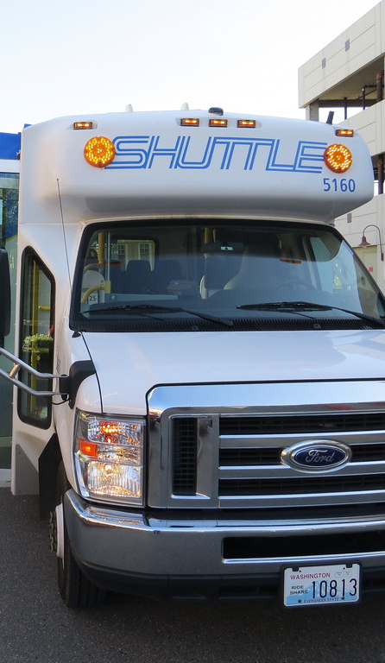
Uses of HTS data
Analysis
Most recent regional travel behaviors & patterns
Trends: comparisons with previous surveys
Model development
SoundCast
Activity-based travel model system
Estimate activity/travel choice models
UrbanSim
Parcel-based land use model system
Estimate residential location choice model
Notes:
There are two primary uses of the survey data
Analysis: it provides insights on the latest behaviors & patterns and allows us to see prevailing trends over time
Models: the data is used as input for PSRC’s travel-land use modeling system

Slide 6
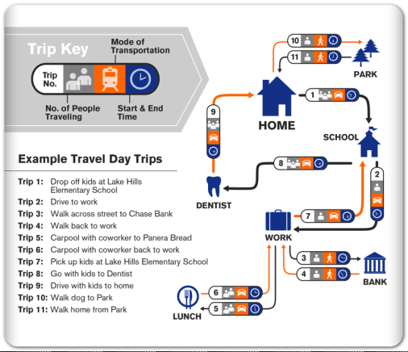
Information in the HTS data
Who is traveling?
Where are they going?
When do they travel?
Why are they going?
How do they get there?
Planning/policy questions
How much do people walk?
How does transit use vary by race?
What kinds of households get home deliveries?
How often do workers typically telecommute?
What households are displaced from their homes?
Notes:
What information is in the travel survey data?
It includes household and person demographics, household vehicle information, and information about daily travel patterns (such as locations, travel times, travel modes)
It basically answers many of the who, where, when, why, and how questions that planners and policy makers want to know about

Slide 7
The 2023 HTS data – The connections are the magic
Directly observed demographics:
Age
Disability (new)
Education
Gender
Income
Race & ethnicity
Sexuality (new)
Examples of planning topics for analysis:
Active travel
Electric vehicle charging (new)
Home deliveries
Public transit use
Residential displacement
Shopping & travel purposes
Working at home
Vehicle miles travel & greenhouse gas emissions
Notes:
What makes this data useful is the direct connections between behaviors and sociodemographics
Some demographics include person- and household-level characteristics (left)
Examples of behaviors that relate to planning include a variety of travel, work, and everyday life activities

Slide 8

2017, 2019, & 2023 samples
Representative samples
2017 sample
3,275 households
Redmond & Seattle add-ons
2019 sample
3,044 households
Seattle add-on
2023 sample
3,661 households
Bellevue & Seattle add-ons
Sampling & stratifications
Random address sample from USPS
Targeted areas for oversampling
Low-income, no vehicles, race, renters, young adults, Regional Growth Centers
Lower expected response rates including rural areas
Notes:
Here’s some high-level summaries of the data from 2023, 2019, 2017
We surveyed over 3000 households in each year, including add-ons
All data collection periods were in the spring, planned around various school breaks and holidays
A quick note on methodology
What makes the data from these surveys representative of the region’s residents is the way that respondents are sampled
We purchase random samples of addresses from the USPS
Then we strategically create stratifications, or sub-groups, to oversample different targets to help ensure we have statistically valid representation
Additional info:
Oversampling
Targeted areas with highest presence of HH types & travel behaviors that are typically underrepresented
HHs with lower income, HHs w/o vehicles, bike/ped commuters, renter HHs, & young HHs
Also focus on Regional Growth Centers
Compensatory
Sampling at higher rates according to expected response rates (BGs divided into low, medium, high)
2021 numbers are summarized here because of the COVID-19 pandemic; the survey setup was slightly different

Slide 9
Considerations when Interpreting HTS
Weighted to match Census American Community Survey totals:
Geography, household size, gender, race, age, income, education, worker status, vehicle ownership
Specific to weekday travel
Adult travel focus
Only adults answer the survey
Joint travel is included, not travel by children alone
Notes:
Statistical weights account for the responses, to match Census breakdowns across multiple demographic dimensions.
As separate data source, estimates will not precisely match Census totals across attributes not used in the weighting.
Weights disregard weekend travel.
By design, children do not answer the survey for themselves, and as a result some child travel isn’t captured. In this presentation we’ll focus solely on adult travel, for simplicity.

Slide 10
Priority Populations in the 2023 Survey
Partial data or inadequate sample:
Age < 18
Limited English
Available:
Race/ethnicity
Age 65+
Disabilities
Low income
No vehicles
Source: 2023 PSRC Household Travel Survey
Notes:
As mentioned, youth travel isn’t fully captured by the survey. Additionally, the sample isn’t sufficient to adequately represent those with limited English proficiency.
However, the other five groups are each adequately represented, with results now available for the first time for disability status, added to the survey last year.

Slide 11
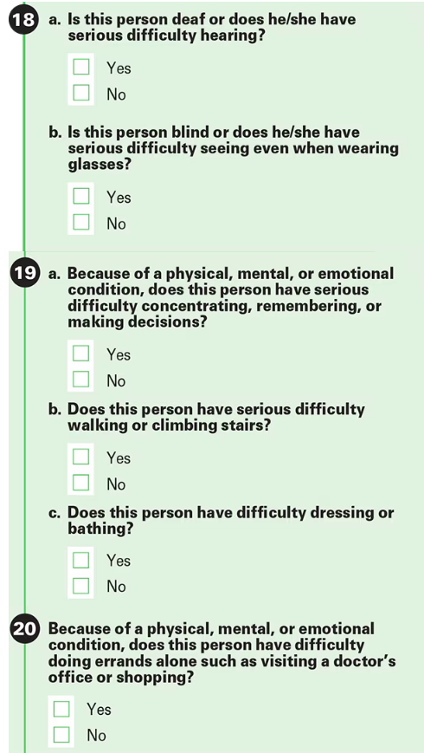
Census ACS Disability Questions
1yr 2022 estimate: 15% “Yes”
US Census Bureau, 2022 ACS Questionnaire

Slide 12
HTS Disability question
Do you have a disability or illness that affects your ability to travel?
Selections | Respondents | Weighted Population | Weighted Share
○ Yes | 472 | 245,500 | 7%
○ No | 5,429 | 2,911,000 | 88%
○ Prefer not to answer | 278 | 151,000 | 5%
Source: 2023 PSRC Household Travel Survey
Notes:
Generally, when many respondents choose ‘Prefer not to answer’, it limits our ability to draw conclusions from the survey.
In this case, however, 87 percent of those responding “prefer not to answer” category are over age 65.
In a way it might be seen as a legitimate third response; they may consider age-related limitations don’t qualify as a disability.
In these results, we focus only on the contrast between the clear ‘yes’ and ‘no’ responses.

Slide 13
Results from the 2023 Survey
1) Relative amount of travel: trip shares
2) Mode of travel: mode splits

Slide 14
Trip Shares
 | Share of regional
 | Adults (reference)
65 years or older | 19%
With disability | 7%
Under $25K income | 7%
No vehicle | 6%
We can compare these groups’ travel behavior to the region by comparing their share of the population to their share of trips.
The group share of the adult population is our reference value.
Source: 2023 PSRC Household Travel Survey

Slide 15
Trip Shares
 | Share of regional
 | Adults (reference) | Trips
65 years or older | 19% | 19%
With disability | 6% | 7%
Under $25K income | 6% | 7%
No vehicle | 6% | 4%
In this case, three of the groups make trips just as frequently as everyone else.
The difference is those without a vehicle. They travel two-thirds as often as the general public.
Source: 2023 PSRC Household Travel Survey

Slide 16
Trip Shares - Grocery
 | Share of regional
 | Trips | Adults (reference) | Grocery trips
65 years or older | 19% | 19% | 25%
With disability | 7% | 7% | 11%
Under $25K income | 7% | 7% | 13%
No vehicle | 4% | 6% | 7%
Older adults, those with disabilities, and low-income families shop for groceries during the week more frequently than the general public.
Grocery trips for households without a vehicle were no different than their reference share (accounting for the error margin).
Source: 2023 PSRC Household Travel Survey

Slide 17
Trip Shares - Medical
 | Share of regional
 | Trips | Grocery trips | Adults (reference) | Medical trips
65 years or older | 18% | 25% | 19% | 31%
With disability | 6% | 11% | 7% | 13%
Under $25K Income | 5% | 13% | 7% | 6%
No vehicle | 4% | 7% | 6% | 2%
Similarly, these two groups travel much more often than the average resident for medical appointments during the week.
Households without vehicles make a third as many weekday medical trips as the regional average.
Source: 2023 PSRC Household Travel Survey

Slide 18
Workforce
 | share of regional |  |  | Within-group employment rate
 | Adults | Workers
65 years or older | 19% | 7% |  | 28%
With disability | 7% | 4% |  | 35%
Under $25K income | 7% | 7% |  | 49%
No vehicle | 6% | 4% |  | 45%
For work trips, the adult population isn’t as useful for reference as the workforce. A significant proportion of these priority populations are not currently in the workforce. (The age 65+ category, for example, includes many retirees.)
Source: 2023 PSRC Household Travel Survey

Slide 19
Trip Shares – Work
 | share of regional
 | Adults | Workers (reference) | Work trips
65 years or older | 19% | 7% | 8%
With disability | 7% | 4% | 3%
Under $25K income | 7% | 7% | 3%
No vehicle | 6% | 4% | 3%
With this comparison, work trip rates make more sense.
The only significant difference is for low-income workers, who commute less than the average worker.
Source: 2023 PSRC Household Travel Survey

Slide 20
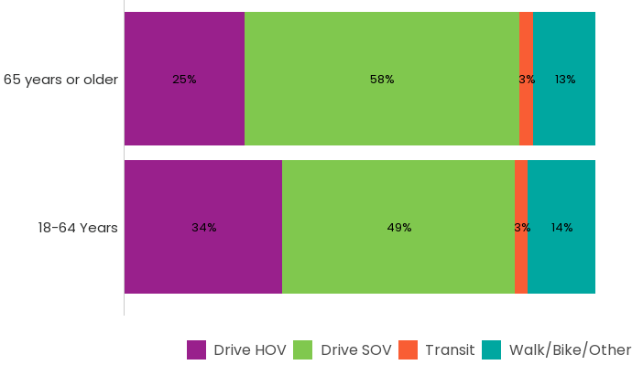
Travel Mode - Age
There are only minor differences in mode choice between age groups.
Source: 2023 PSRC Household Travel Survey
Notes:
HOV 2+ indicates people driving together (high occupancy vehicle). This includes carpools and vanpools, as well as friends or family members riding in the same car.

Slide 21
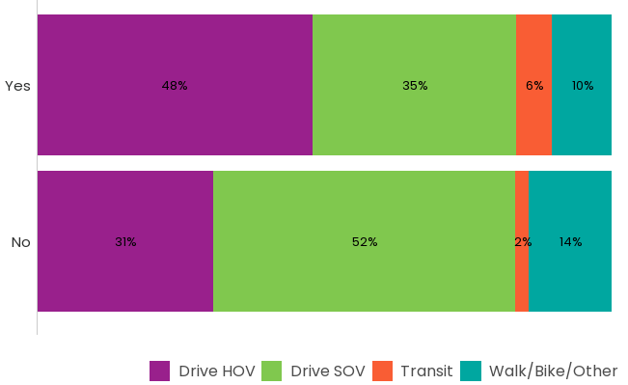
Travel Mode - Disability Status
A similar proportion of trips between groups involve driving, but those with disabilities are more likely to travel with someone else.
Transit use is triple that of the rest of the population.
Source: 2023 PSRC Household Travel Survey

Slide 22
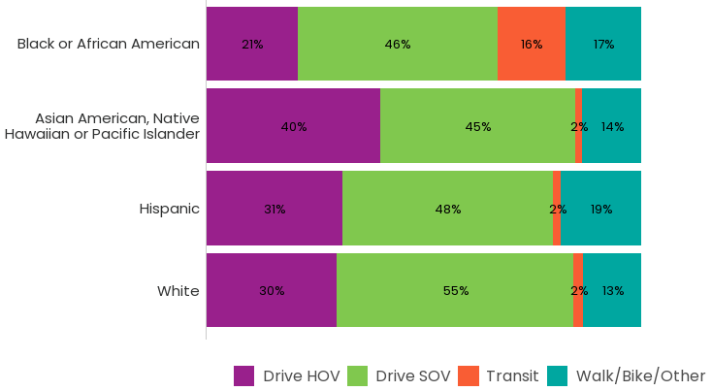
Travel Mode – Race & Ethnicity
Black respondents are more likely to use transit and less likely to carpool.
Source: 2023 PSRC Household Travel Survey

Slide 23
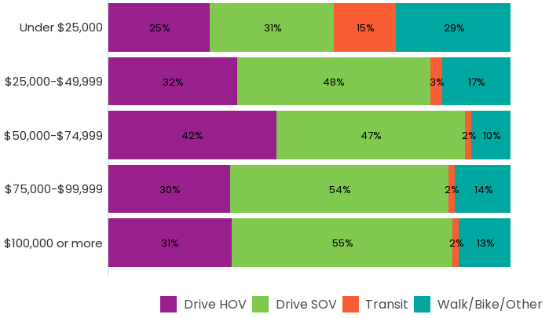
Travel Mode - Income
The more notable differences from regional mode split are in households making less than $25K annually.
These households drive alone less and use transit seven times more than those making over $50K.
Source: 2023 PSRC Household Travel Survey

Slide 24
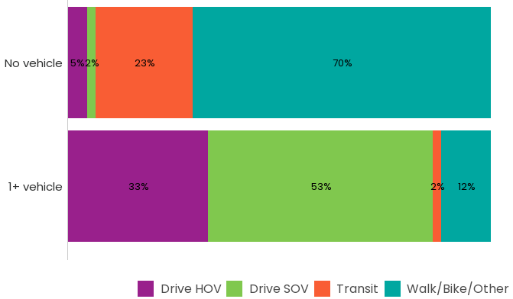
Travel Mode - Vehicle Ownership
Those who own a vehicle are much more likely to drive.
The choice of where to live (including walking & transit access) and whether to own a vehicle are often intertwined.
Source: 2023 PSRC Household Travel Survey

Slide 25
2023 HTS presentation schedule
Group | Date | Time | Topic
Transportation Demand Management (TDM) | 8/27 Tue | 10am-12pm | Workplaces, commutes, telework
Bicycle Pedestrian Advisory Committee (BPAC) | 9/10 Tue | 10am-12pm | Walk, bike, roll
Coordinated Mobility & Accessibility Committee (CMAC) | 9/18 Wed | 9:30-11:30am | People with disabilities, older adults, youth, people with lower income, people with limited English proficiency
Transit-Oriented Development (TOD) | 9/20 Fri | 10am-12pm | Transit & other modes, Regional Growth Centers (RGC) & High-Capacity Transit (HCT) communities
Freight Advisory Committee (FAC) | 10/9 Wed | 9:30-11am | Deliveries & other travels induced by residents
Transit Operator Committees (TOC) | 10/23 Wed | 10am-12pm | Focus on transit behaviors
Regional Staff Committee (RSC) | 11/21 Thu | 9:30-11:30am | Highlights from all topics
Notes:
Presentations that have already occurred are in grey and italics

Slide 26
2025 HTS Timeline
2024 | October | Start 2025 HTS project with consultants
2025 | February – June | Data collection
 | July | Data cleaning, processing, weighting begins
2026 | March | Final data delivery & publication

Slide 27
Michael Jensen
Senior Data Programmer/Analyst, mjensen@psrc.org
Suzanne Childress
Principal Data Scientist, schildress@psrc.org
Thank You!
Brian H. Y. Lee, Ph.D.
Program Manager, blee@psrc.org

Slide 28
Priority Populations are Interrelated
Disability Status | Without vehicle | Income < $25K
With disability | 20% | 30%
No disability | 5% | 5%
Source: 2023 PSRC Household Travel Survey

Slide 29
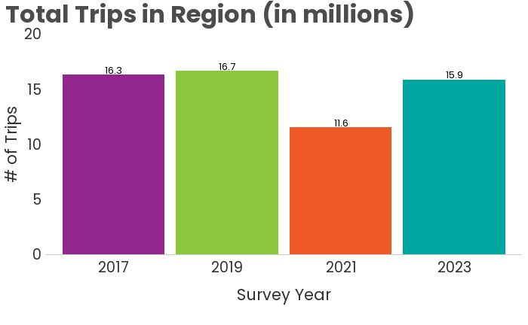
Regional Trip Count Trend
Number of trips made on an average weekday in 2023 is nearly back to pre-pandemic amount

Slide 30
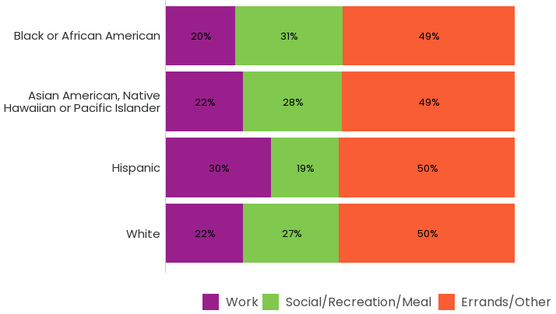
Trip Purpose by Race - 2023
Hispanic respondents, who reported the most travel overall, also reported substantially more work trips.
Black respondents reported the fewest trips (both work trips, and trips overall).
Asian and Non-Hispanic Whites travel patterns are nearly identical and fall in-between the other two.

Slide 31
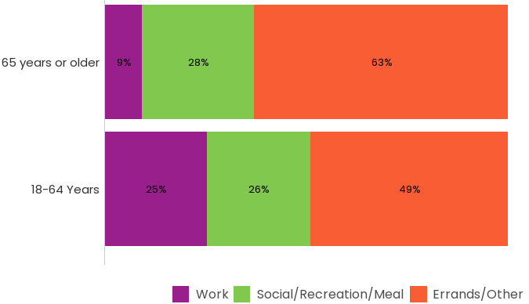
2023 Trip Purpose by Age
The largest category for either age group is errands (e.g. medical appointments, shopping).
For retirees, work trips are largely replaced by additional errands.

Slide 32
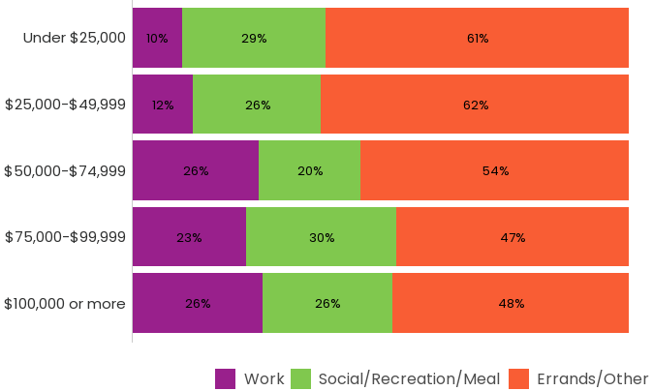
2023 Trip Purpose by Income
Households with lower income also travel less for work, and more on errands.
The share of social & recreational trips is similar across income groups.

Slide 33
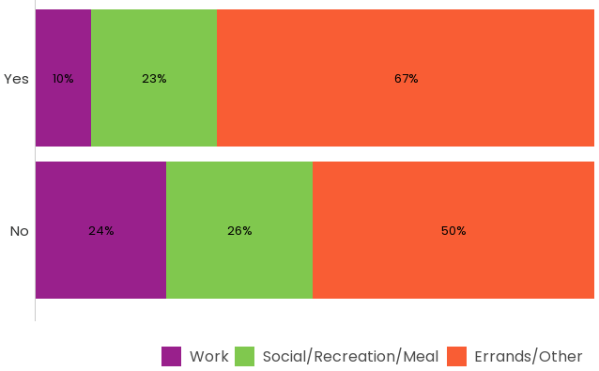
2023 Trip Purpose by Disability Status
For those without disabilities, a greater share of travel is work-related.
A greater share of trips for those with disabilities are errands. Keep in mind they average substantially fewer trips per capita.

